Slide 1
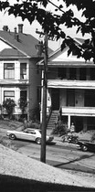

House Price Prediction
Presented by:
Likhitha Konsale Prakash(X23160691)
Shruthi Chandra Babu(X23248556)
Soumya Madhav(X23332018)
This Photo by Unknown Author is licensed under CC BY-SA

Slide 2
Quicker Property Listing Dataset
This Photo by Unknown Author is licensed under CC BY-SA

Slide 3
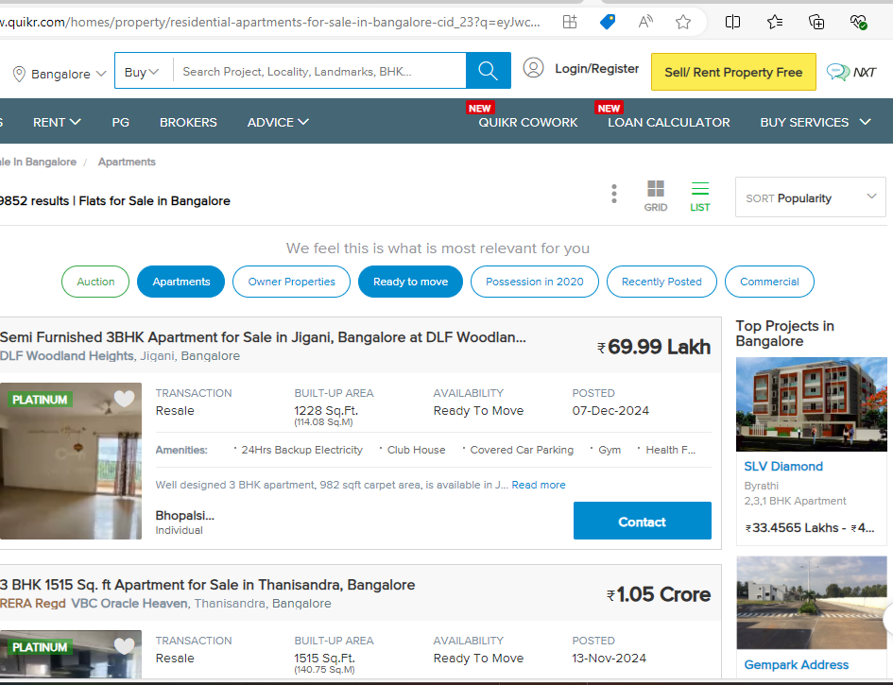
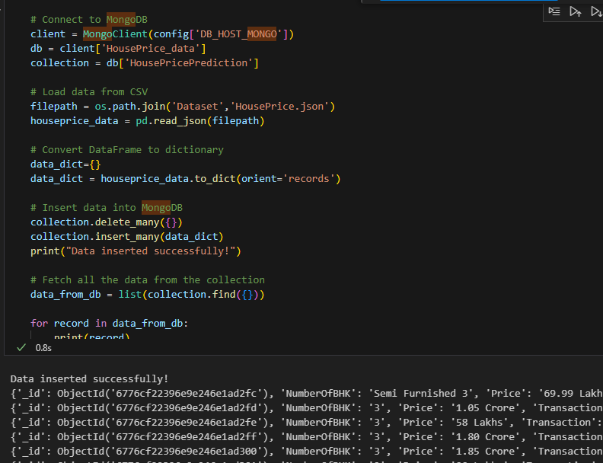
Data Collection and Semi-Structured Data Storage
Data Source:
Scraped from Quicker Property Listing (Bangalore section)
Tools Used:
Web Scraping: Selenium (Headless mode)
Highlights:
Collected data from 100+ pages, yielding 2100 records.
Attributes Extracted:
BuiltUpArea, AreaName,Number of BHK, ReraApproval,Posted By, Rera Approval, Transaction,Availability, Price.
Data Storage:
MongoDB for storing semi-structured data in JSON format.
MongoDB queries analyzed patterns like top areas by price and count of new vs. resale properties.

Slide 4

Data Manipulation
Refined numerical fields:
Converted 'Lakhs' and 'Crores' to numeric values, for Price
Removed 'sqft' from BuiltUpArea and suffix 'BHK' from the number of BHKs.
Standardized area names by truncating 'Bangalore’.
Structured Storage:
Data stored as a CSV and then imported into PostgreSQL for structured analysis.

Slide 5
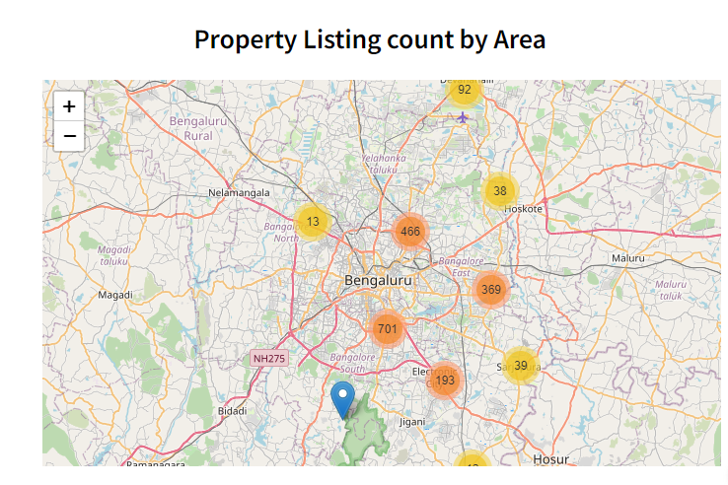
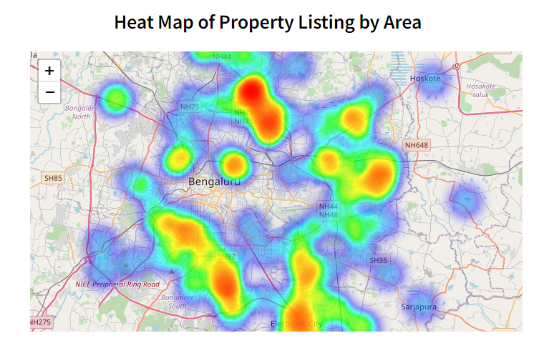
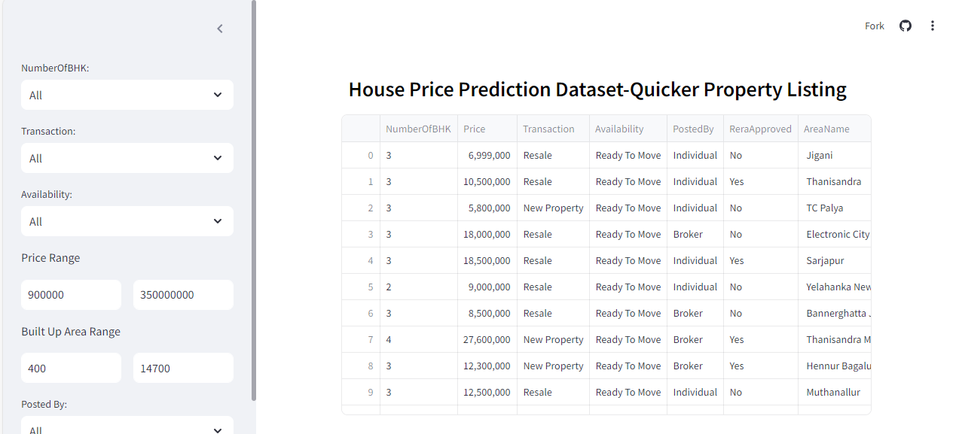
Streamlit Application
Interactive dashboard for property listings and maps.
Data Visualisation tools
Tabular column with filters
Can Download data from tabular column in csv format
Maps
Maps using folium library with zoom in and zoom out feaures in maps
Heatmaps for property density
Area-specific property counts with detailed views

Slide 6

Data Preprocessing and Modelling
Preprocessing:
Label encoding for categorical columns.
Normalization of Price and BuiltUpArea.
Train-test split (80:20) to prevent overfitting.
Models Used:
XGBoost Regressor:
Handles non-linear relationships (Area/Rera Approval vs. Price).
Optimized using Mean Absolute Error (MAE).
Artificial Neural Network (ANN):
Simulates biological networks for complex relationships.
Evaluated using MAE and RMSE metrics.

Slide 7
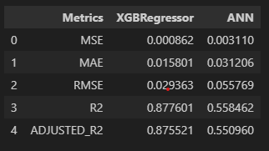
Results
XGBoost Regressor:
Superior performance with lower errors (e.g., RMSE: 0.029363) and higher R² scores (0.877).
ANN Model:
Higher errors (e.g., RMSE: 0.0557) and lower R² (0.550).
XGBoost demonstrated better accuracy and efficiency for house price prediction.
Although ANN is typically efficient at learning complex patterns, the limited dataset size of just 2100 records may have contributed to reduced prediction accuracy. Fine-tuning the model with a larger dataset could potentially enhance the performance of the ANN and yield more accurate results.
ThePhoto by PhotoAuthor is licensed under CCYYSA.

Slide 8
King County Housing Dataset
This Photo by Unknown Author is licensed under CC BY-SA

Slide 9
Data collection and Storage
In this method the housing dataset of is obtained from Kaggle that has the house sale prices for King County.
The dataset has around 21000 records with 21 unique features of the properties.
As a part of programming the dataset is stored in mongodb database programmatically by creating a database named Housing data and collection named House Price.
Few of the queries were performed after successfully storing the dataset into the database retrieved some data programmatically.

Slide 10

Data Manipulation
The date column is converted to datetime format.
Extratcted the year and month into separate columns.
Few new columns like age of the house, renovated are added to the dataset.
Some irrelevant columns were removed from the dataframe.
As there was an imbalance in the dataset that has been handled.
The manipulated data is been stored to postgresql programatically for further analysis.

Slide 11
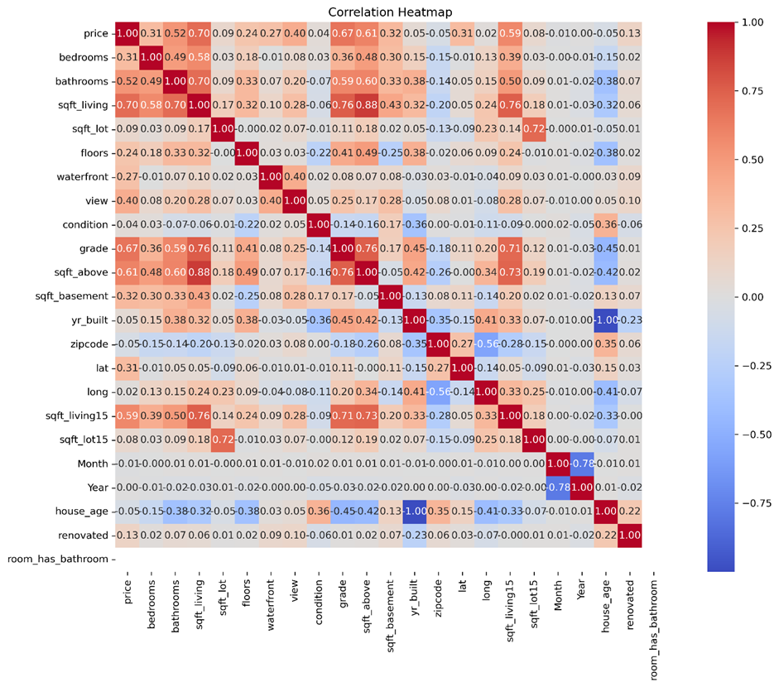
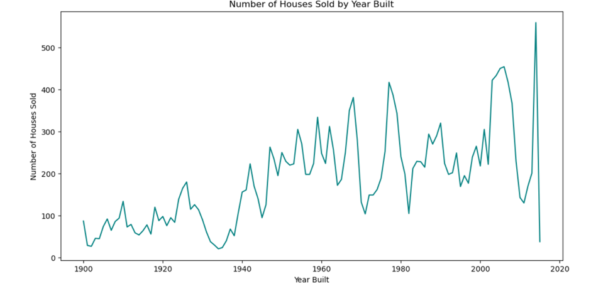
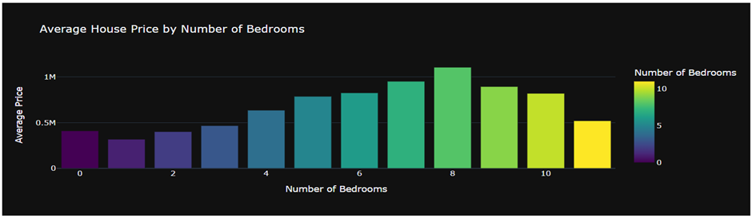
Data Visualization

Slide 12
Data Preprocessing and Modelling
The dataset is been standardized for modelling purpose.
Relevant features are taken for analysis and have split them to train the model efficiently.
Decision tree regressor and XGBoost algorithms are applied to predict the house prices.
The XGBoost algorithm performs better and provides better predictions.

Slide 13
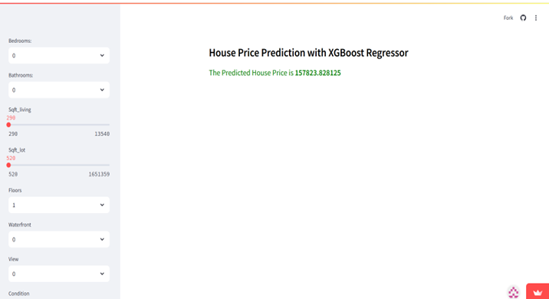
Streamlit Application
The work also includes an interactive streamlit application that is built for visually predicting the house prices based on user input. The system uses XGBoost algorithm to predict the prices.

Slide 14
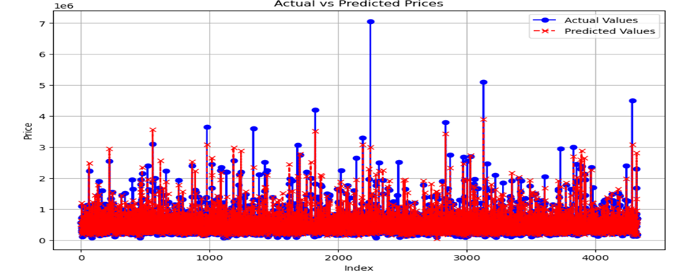
Results
The XGBoost algorithm performs better than the decision tree algorithm with mean absolute error of 64932.696, root mean square of 133601.61 and r squared value of 0.88

Slide 15
Melbourne Housing Data
This Photo by Unknown Author is licensed under CC BY-SA

Slide 16
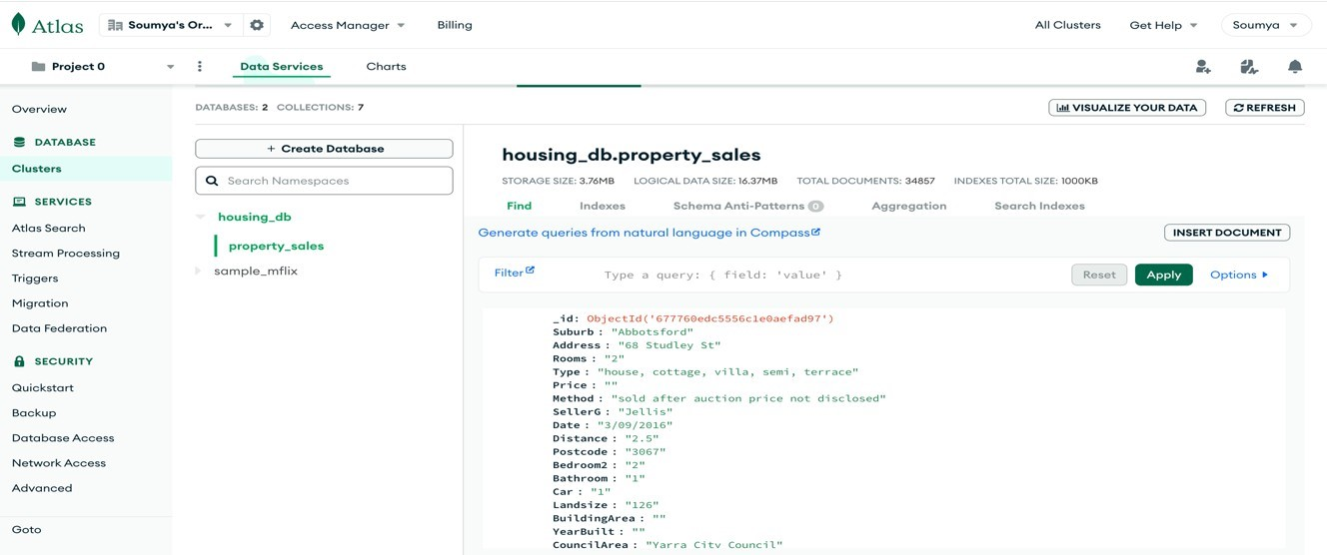
Data collection and storage
This Melbourne housing data exploration utilizes the Melbourne dataset, sourced from Kaggle.
The data is converted into JSON format and stored in MongoDB on the cloud Mongo Atlas platform which provides scalability and ease of access.

Slide 17
Data Analysis
The dataset was loaded into pandas dataframe.
The data set contained 34,857 rows and 21 features.
Missing values in the dataset were identified. Features with more than 50% missing data as well as columns with repeated information like bedrooms were dropped.
Missing values in categorical and numerical features were handled using the Simple Imputer, with values replaced by the mean, median, or mode as appropriate.
The outliers are identified using box plots and treated using capping method for Price column.
The cleaned dataset is stored in PostgreSǪL,on NEON a cloud-based database service using sqlalchemy .

Slide 18
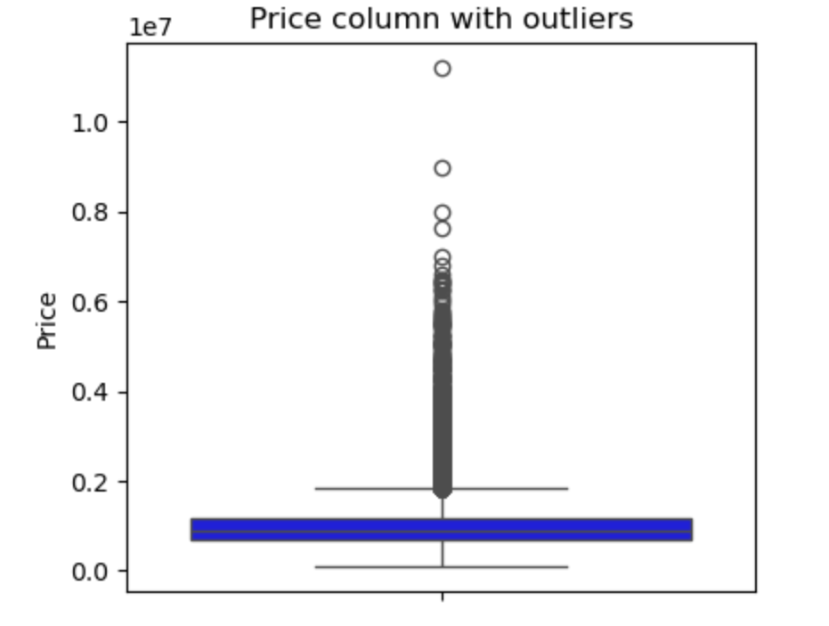
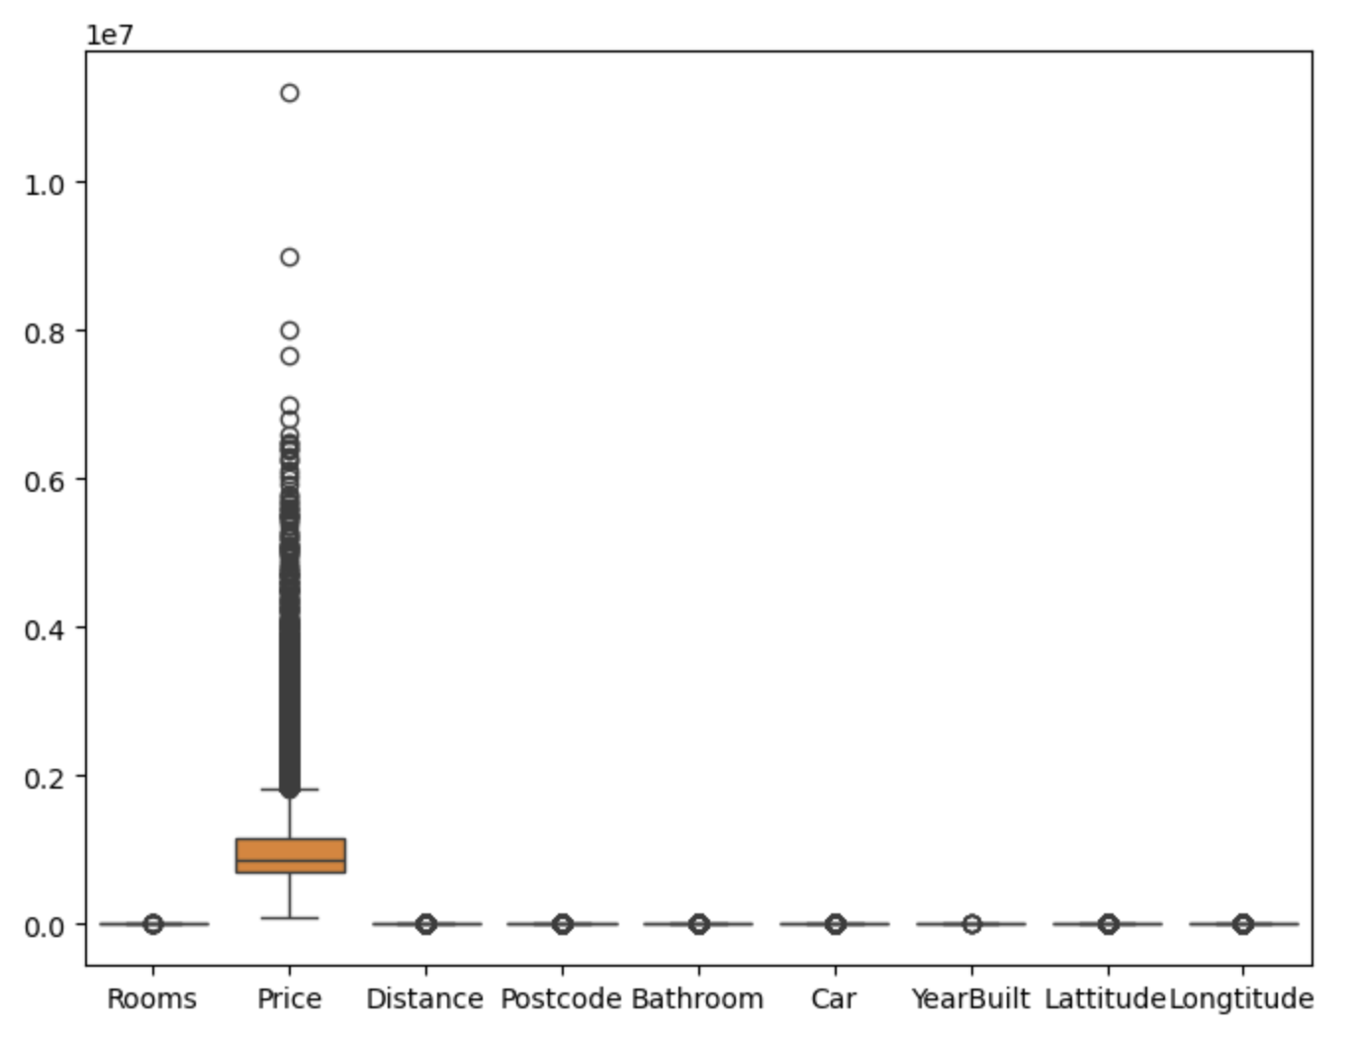
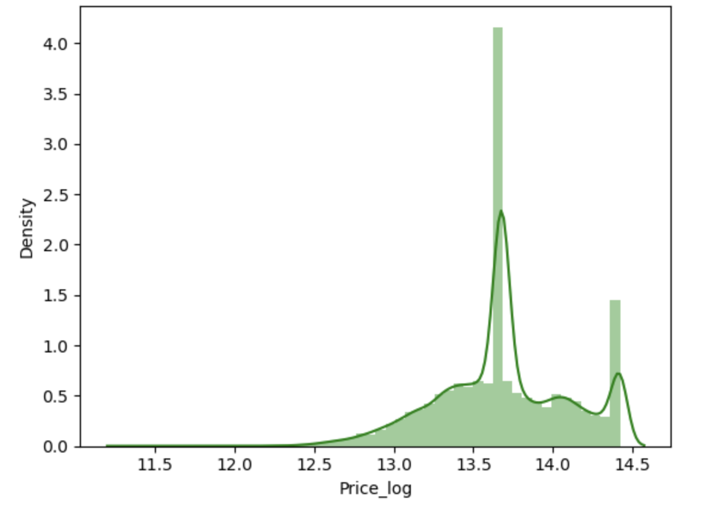
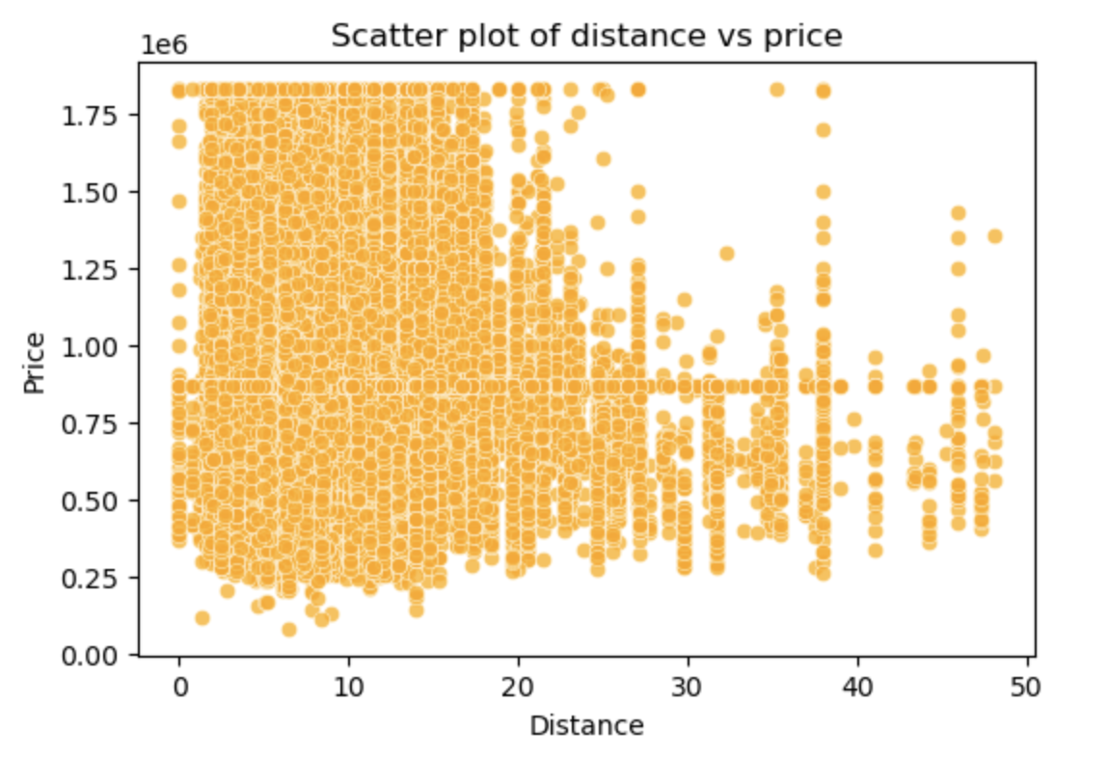
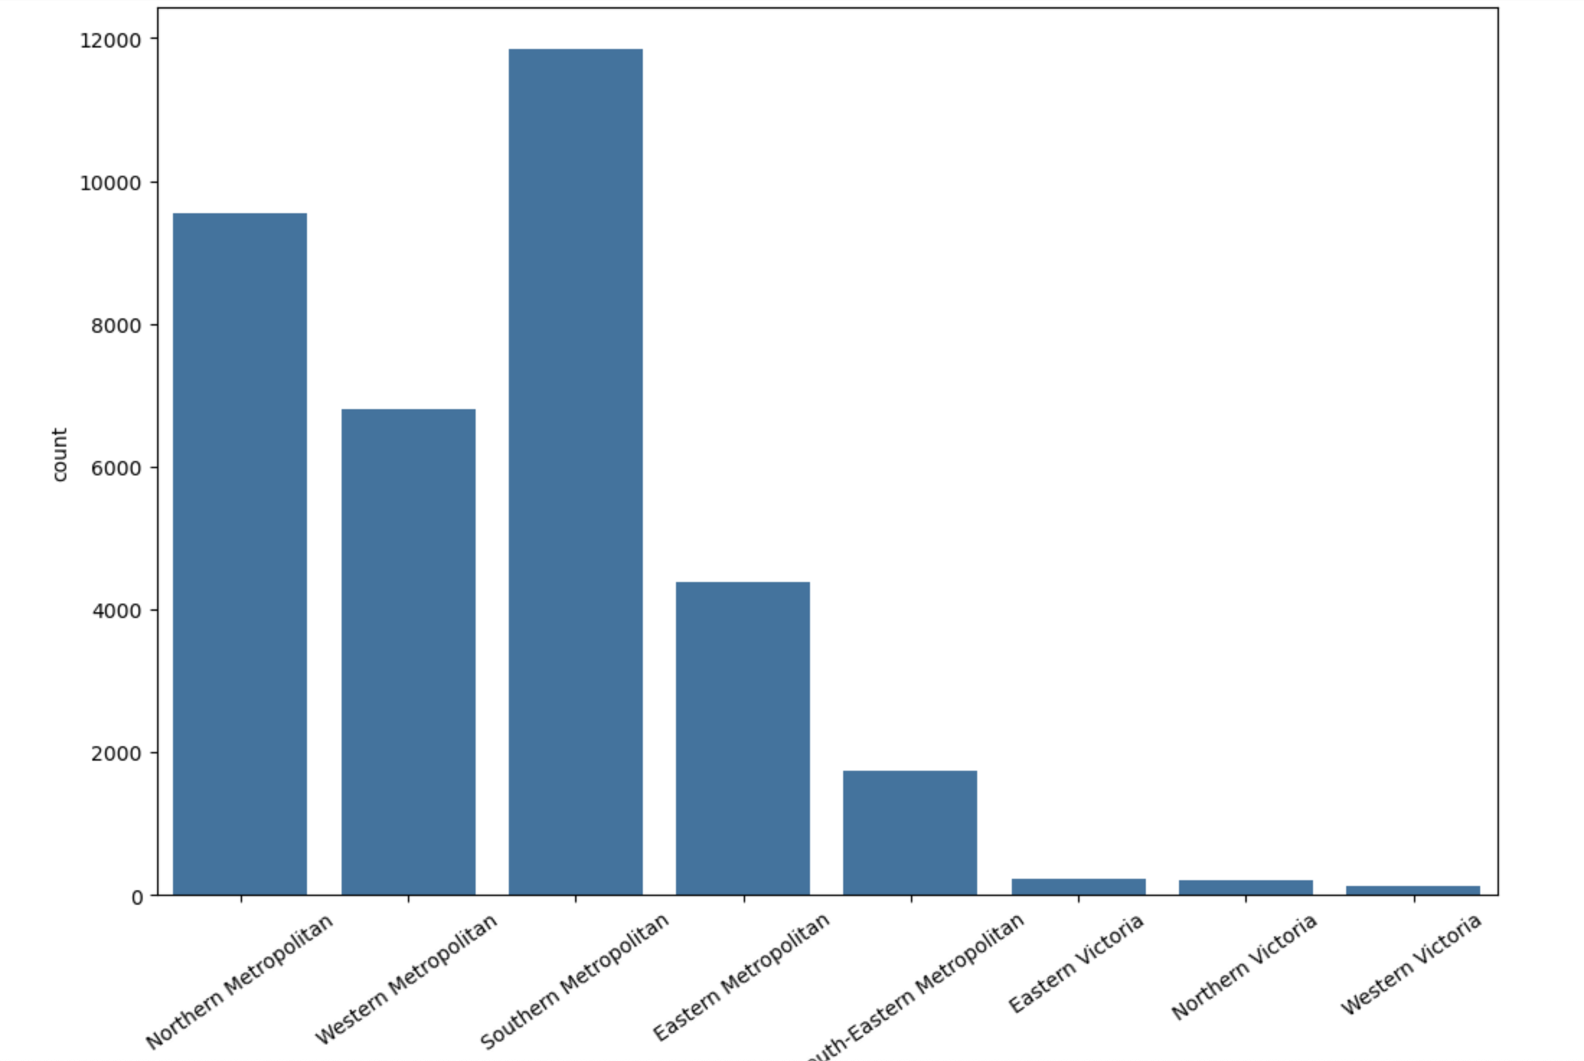
Data Visualization

Slide 19
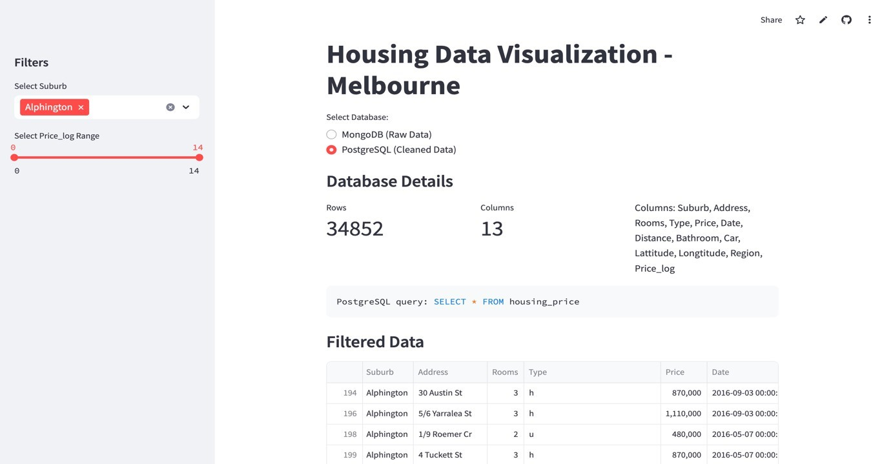
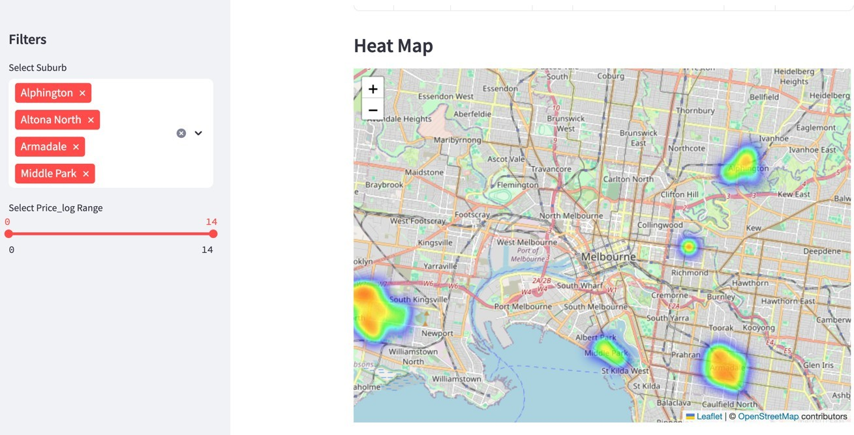
Streamlit Application
An interactive Streamlit app was built to access and visualize the data stored in both MongoDB and PostgreSQL.
The app provides a clean user interface to switch between the raw data in MongoDB and the refined data in PostgreSQL , enabling comparative analysis.
The filtered data is displayed in a table, and a heatmap visualization highlights the geographic distribution of properties and their respective prices.

Slide 20
Results
Linear Regression, a straightforward algorithm for modeling relationships between dependent and independent variables, achieved a training score of 0.3414 and a testing score of 0.3358, indicating moderate performance.
The decision tree model that splits data into subsets based on feature values to make predictions, delivered the highest training score of 0.6984 and a testing score of 0.4261, demonstrating overall better performance in capturing the underlying patterns.

Slide 21

Conclusion
The analysis revealed that XGBoostRegressor outperformed other models, particularly in handling non-linear relationships in the Quikr and Kings County datasets.
Decision Trees demonstrated robust performance on the Melbourne dataset, emphasizing their suitability for region-specific modeling.
Key features like built-up area, property location, and price exhibited significant influence across datasets.
Data preprocessing techniques, including normalization, encoding, and outlier handling, significantly enhanced the metrics of the models.

Slide 22

Thank you

